Slide 1
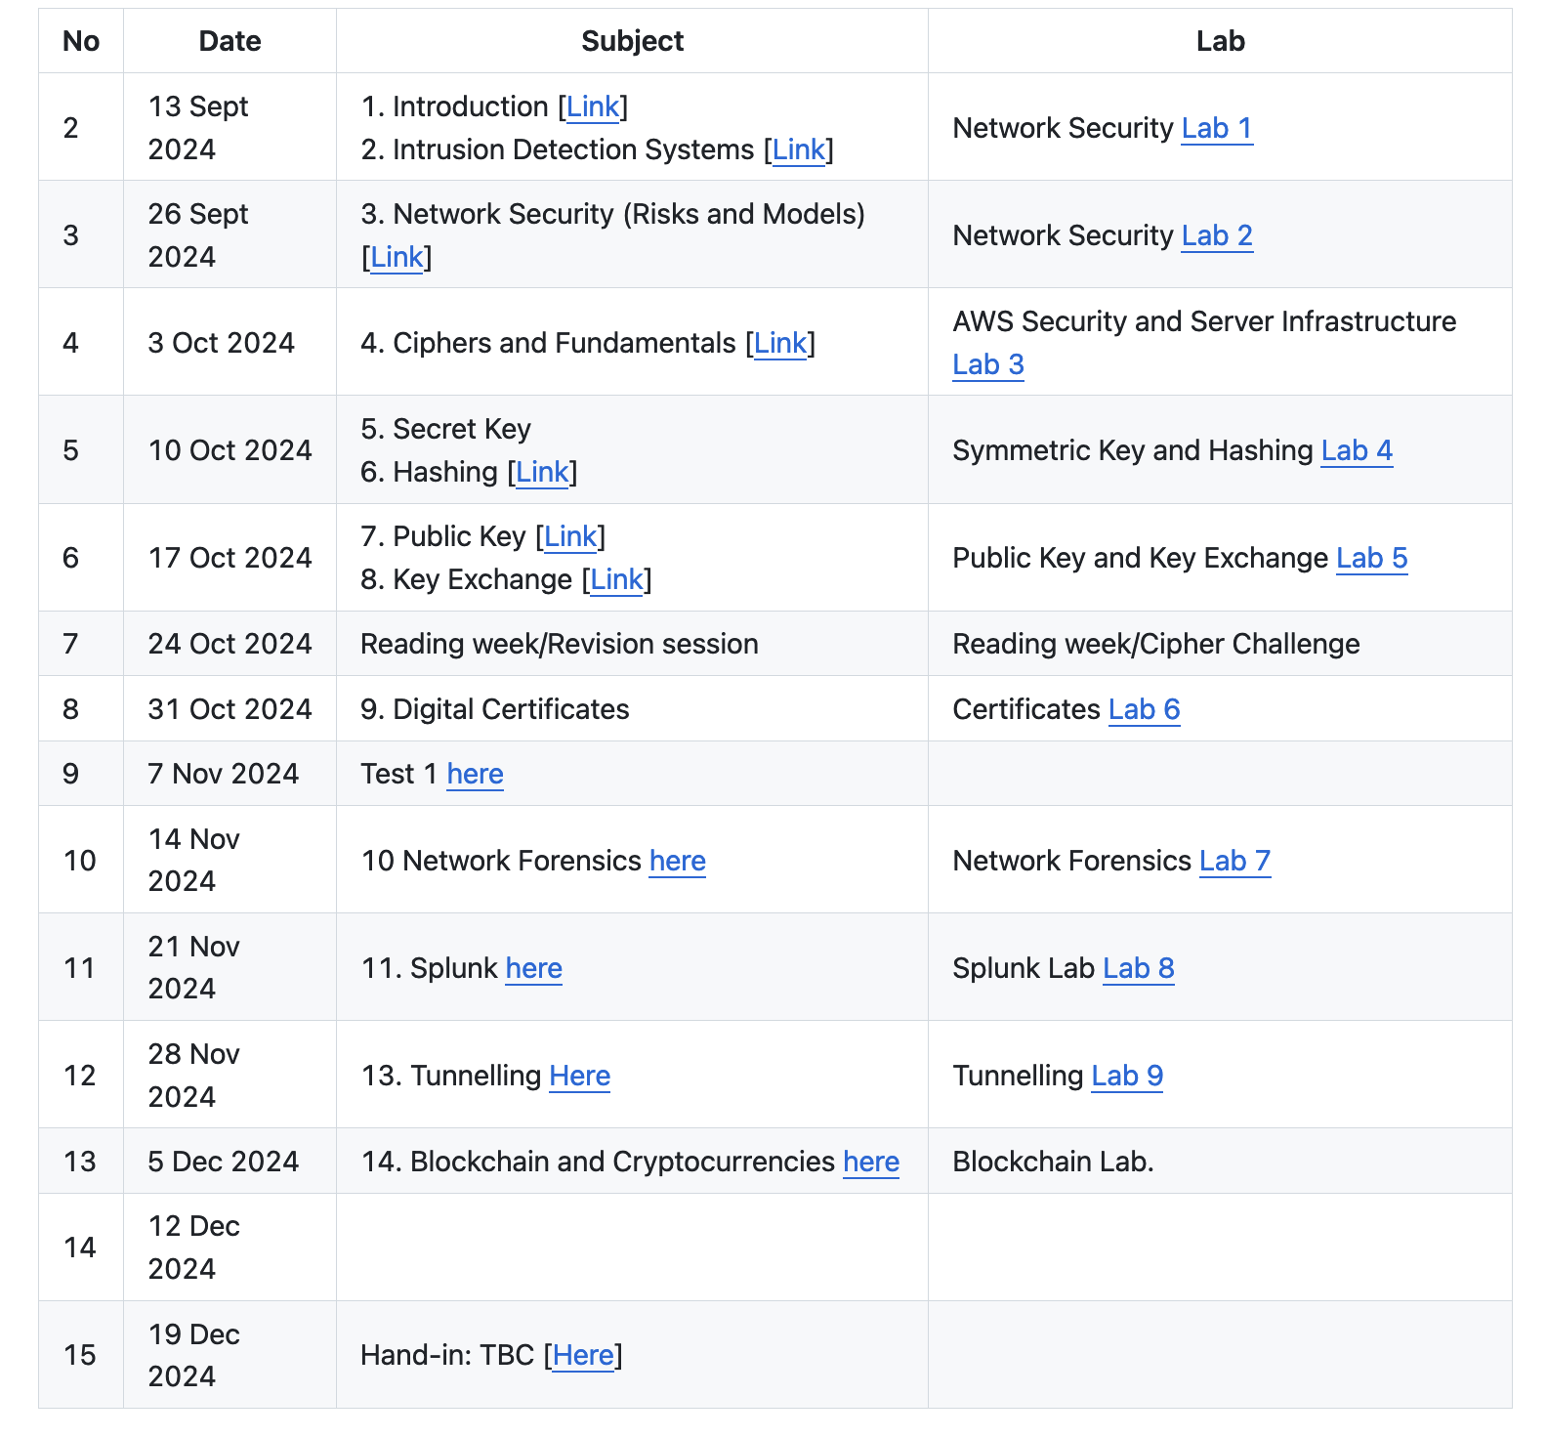
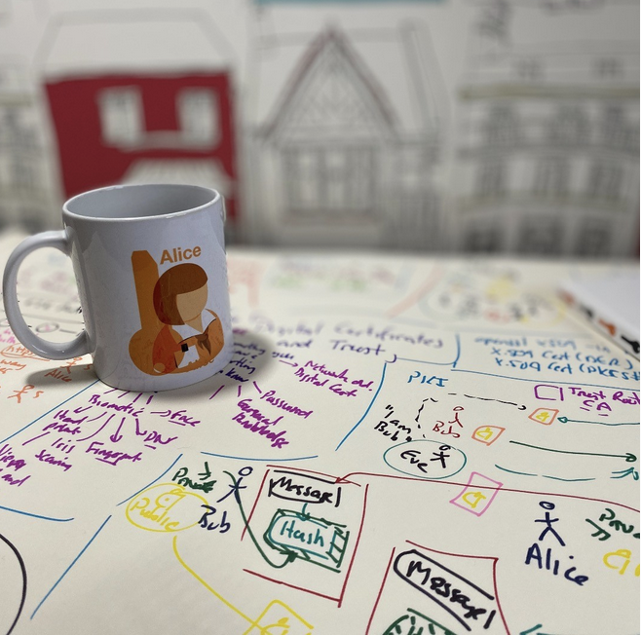
Tunnelling Basics. SSL/TLS. VPNs. Prof Bill Buchanan OBE https://asecuritysite.com/tunnelling

Slide 3
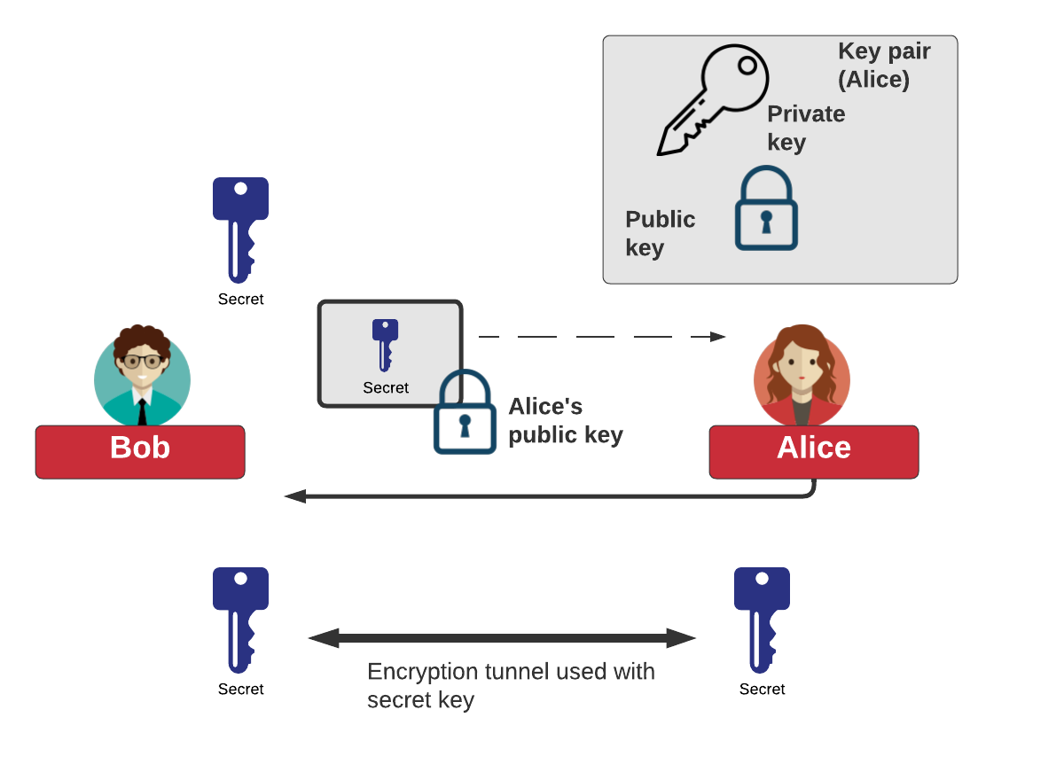
Tunnelling

Slide 4
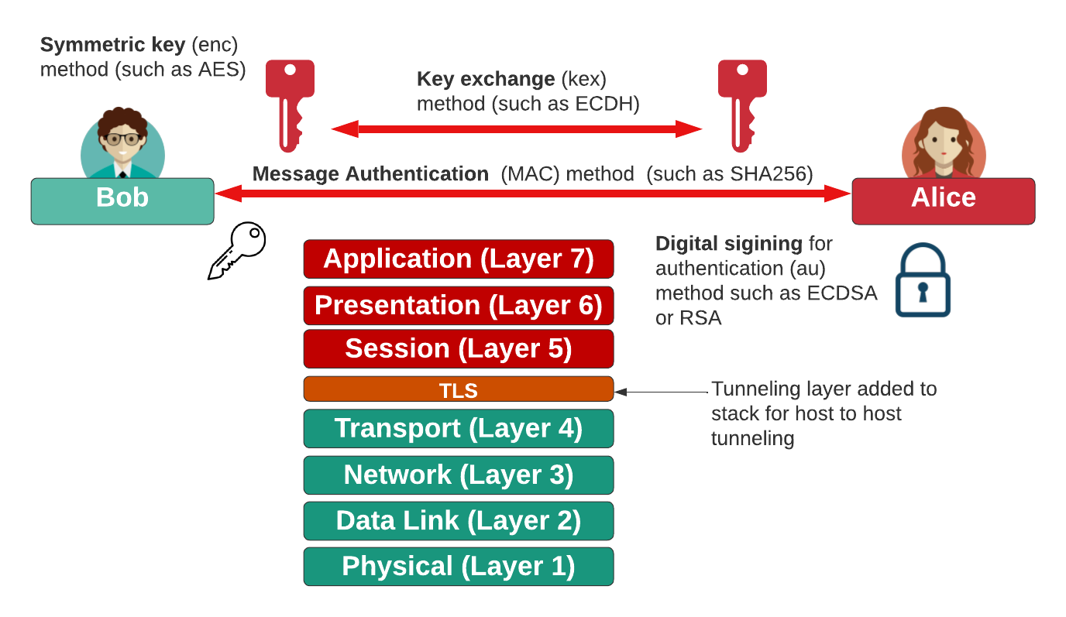
Tunnelling

Slide 5
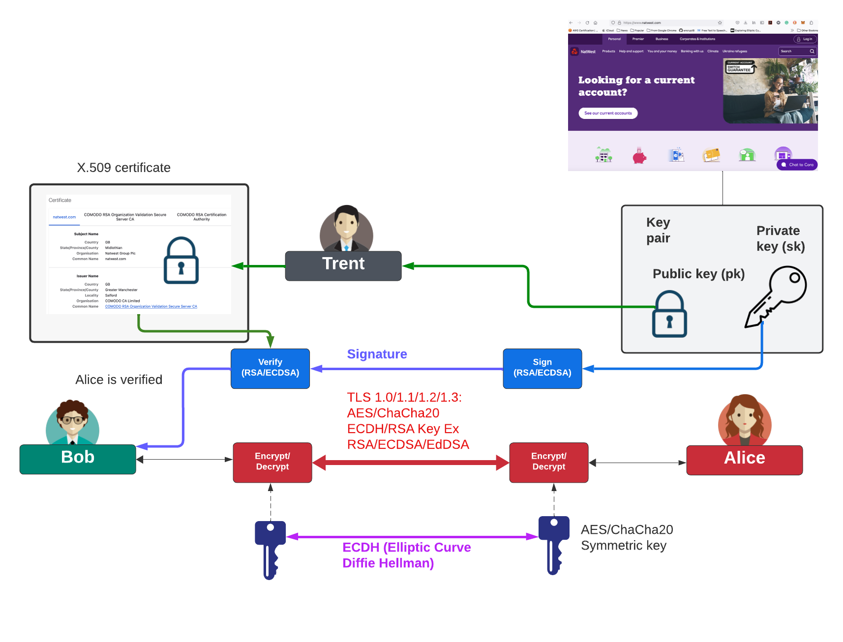
Tunnelling

Slide 6
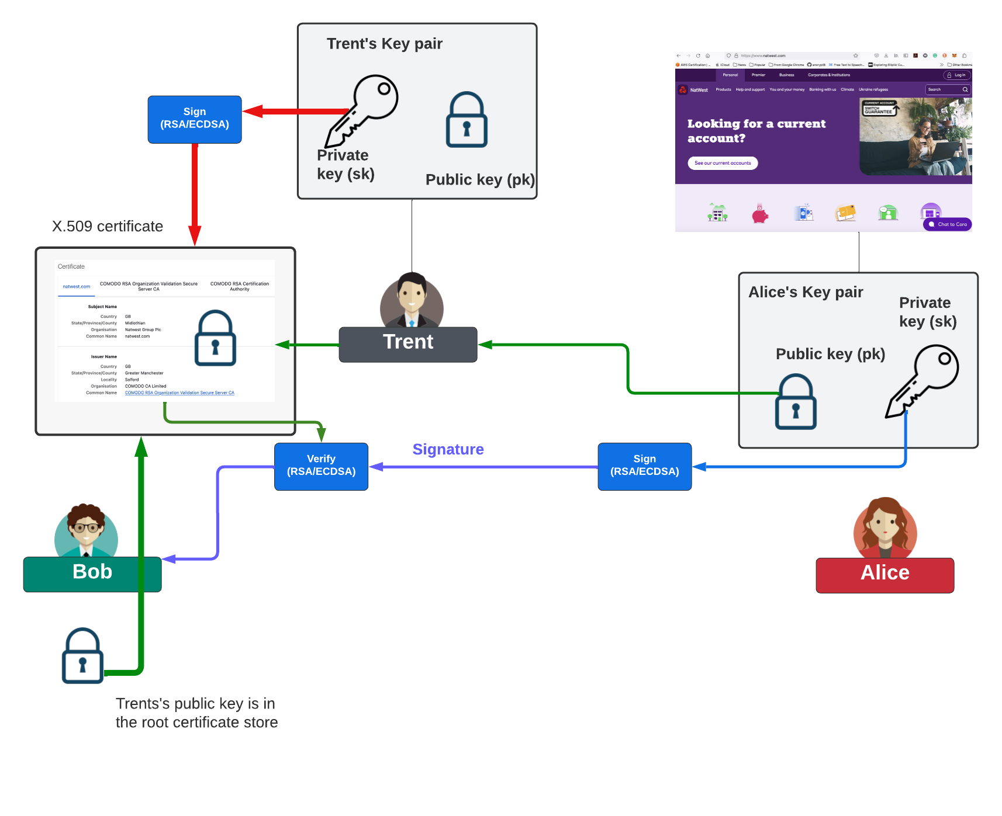
Tunnelling

Slide 7
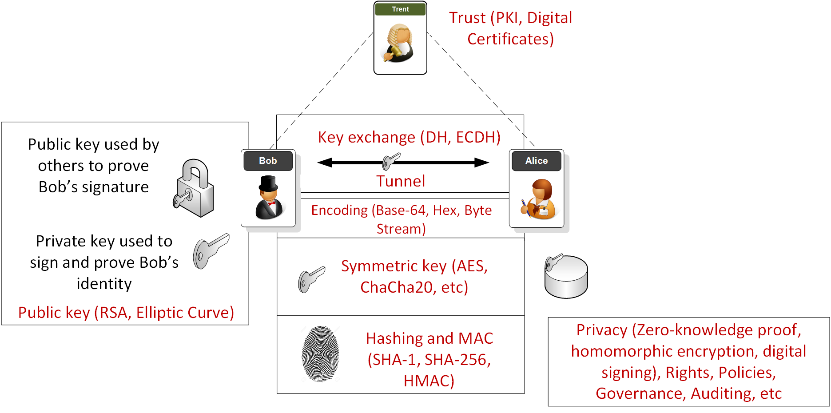
Overview

Slide 8
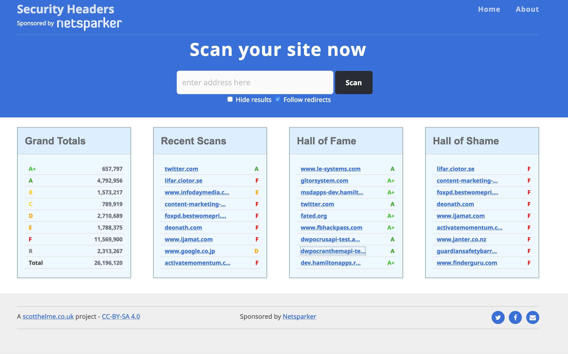
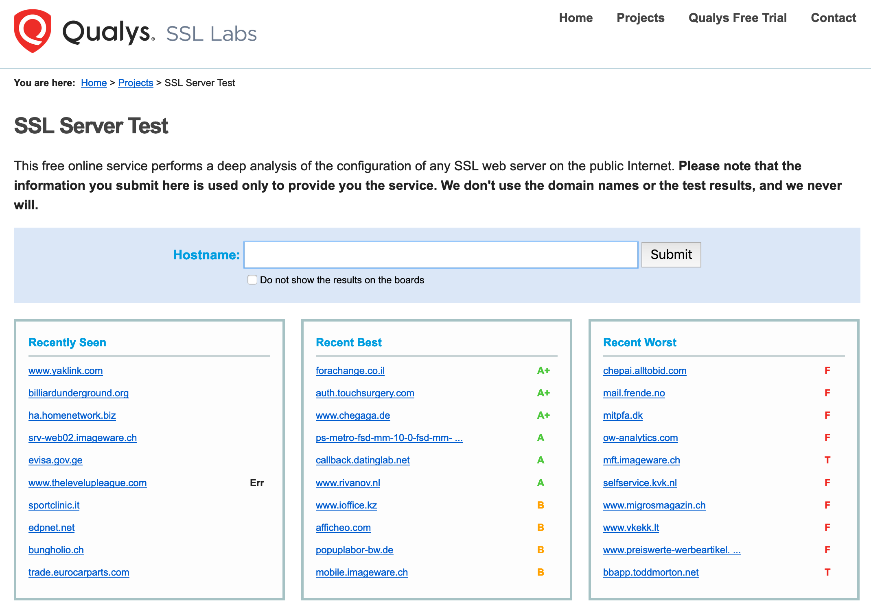

Slide 9
Tunnelling Basics. TLS. VPNs. Prof Bill Buchanan OBE https://asecuritysite.com/tunnelling

Slide 22
Tunnelling Basics. TLS. VPNs. Prof Bill Buchanan OBE https://asecuritysite.com/tunnelling

Slide 31
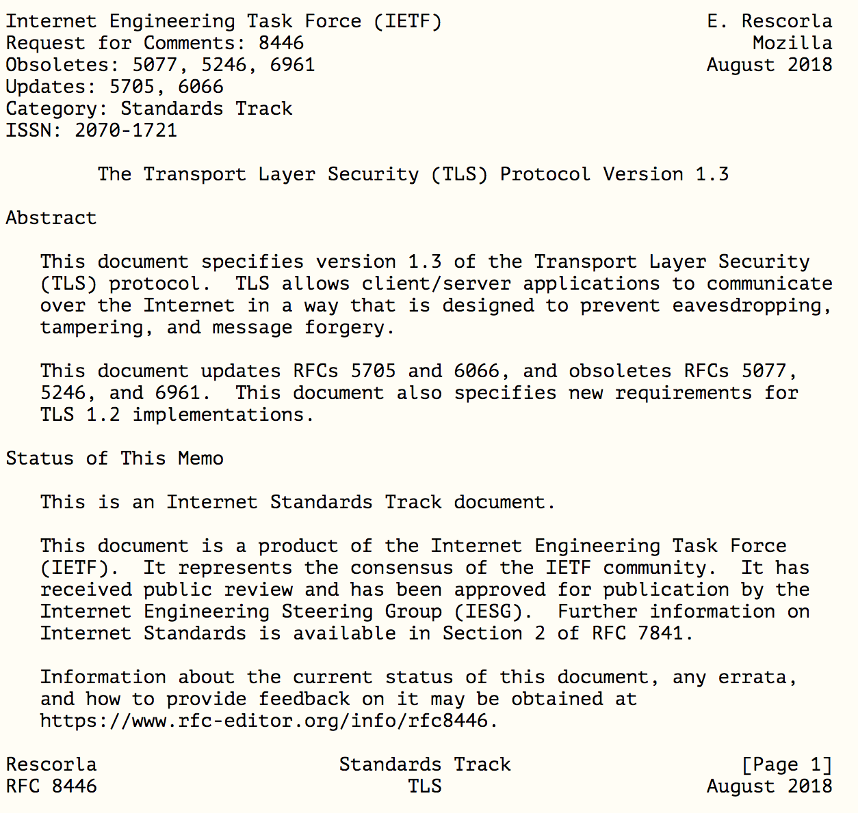

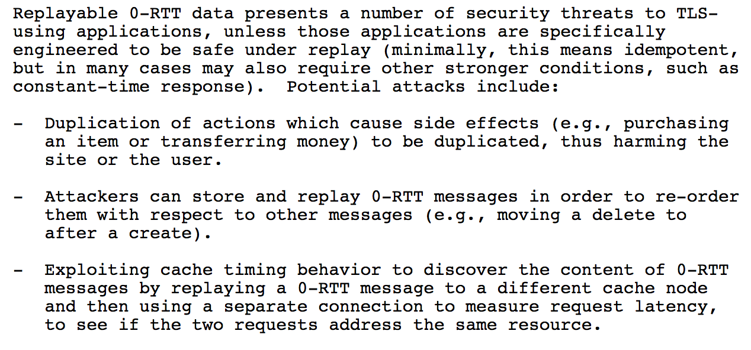
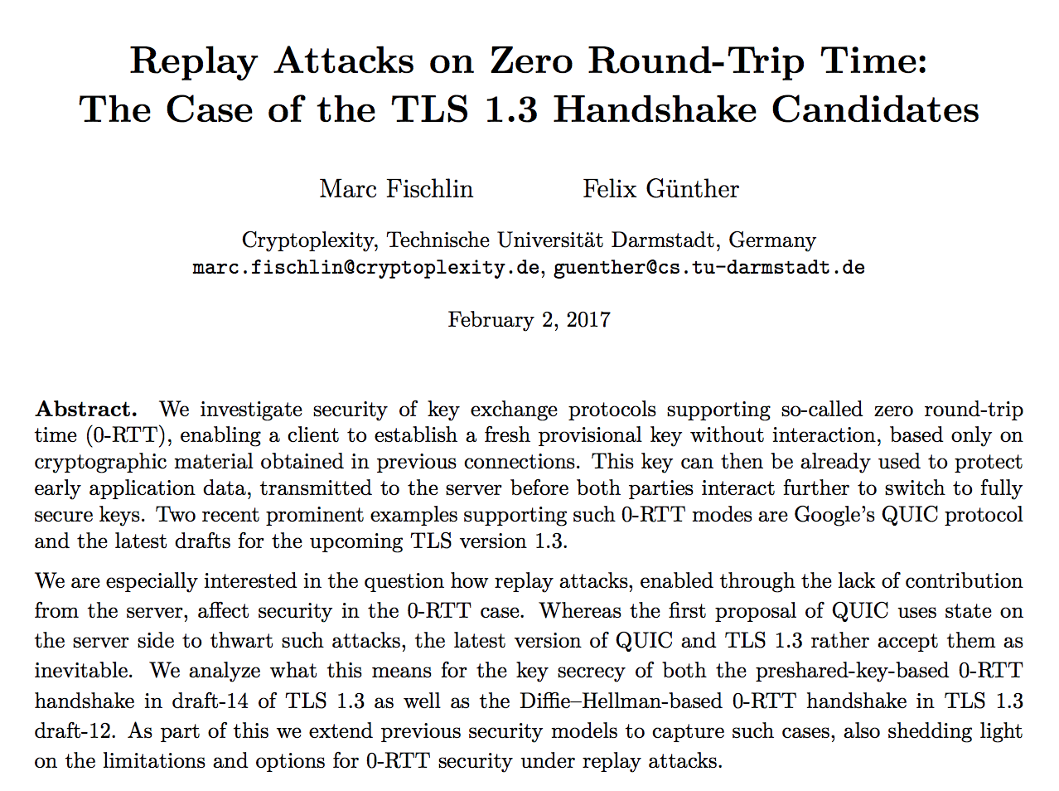

Slide 32
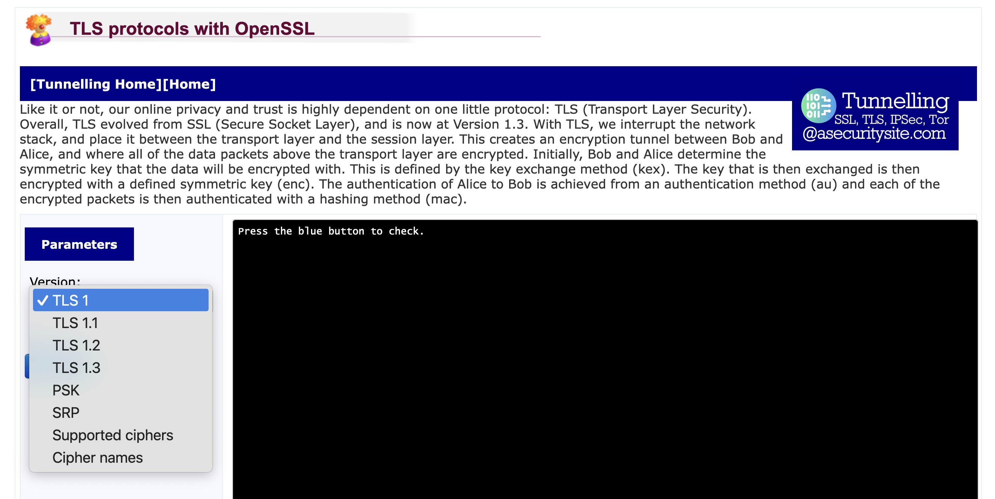
TLS Versions

Slide 33
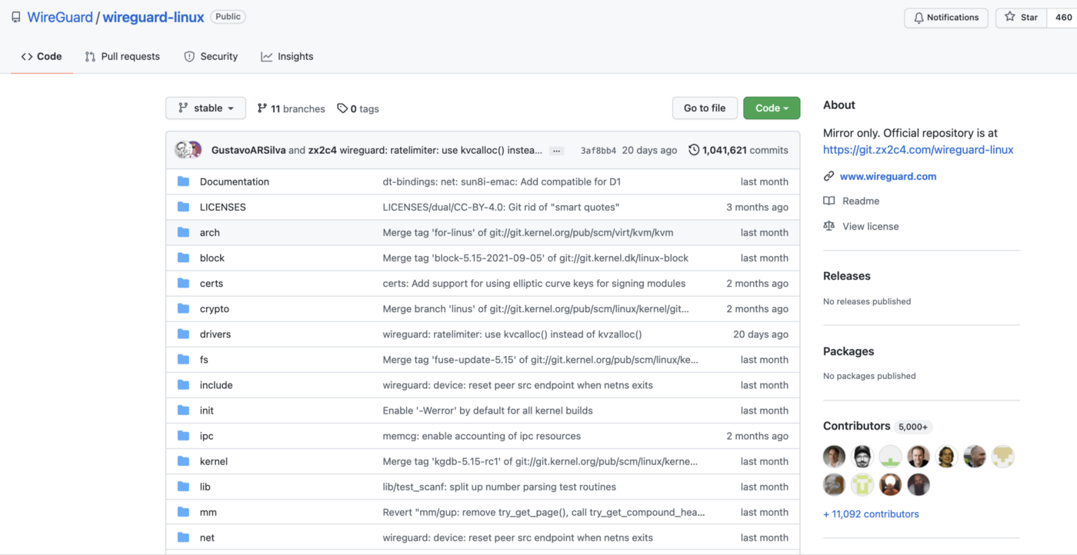
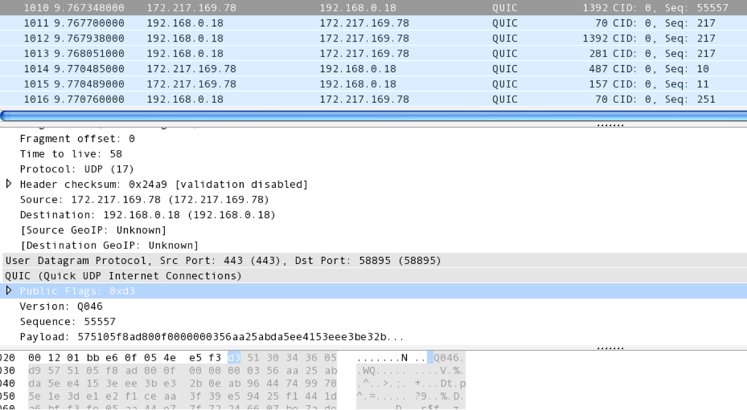
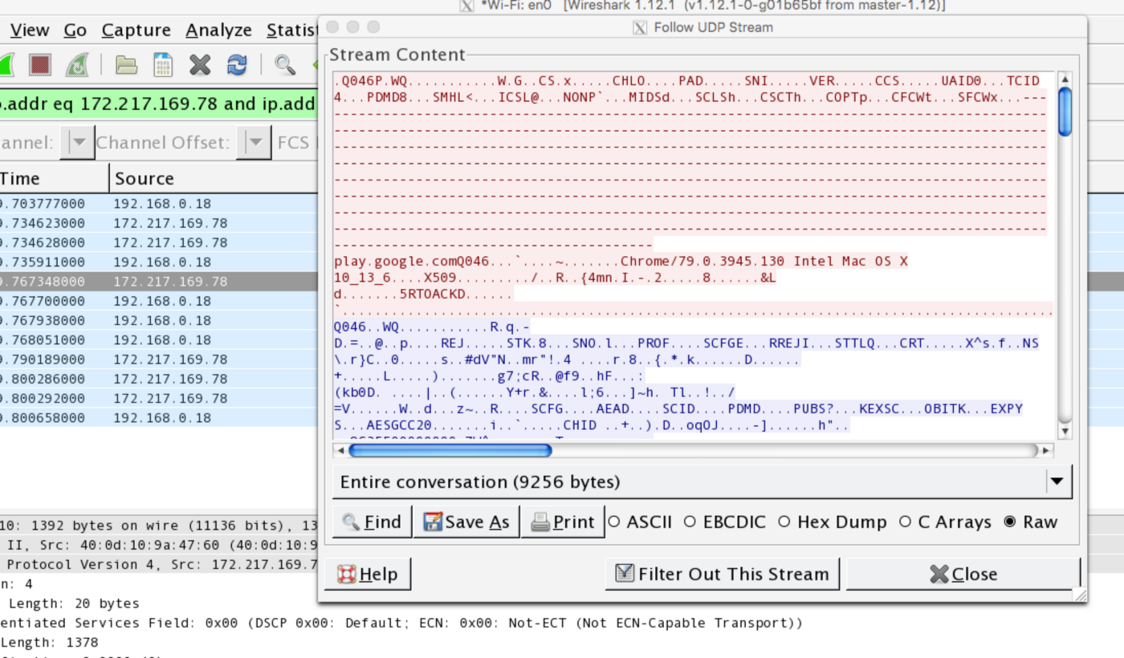
QUIC and WireGuard

Slide 34
Tunnelling Basics. TLS. VPNs. Prof Bill Buchanan OBE https://asecuritysite.com/tunnelling

Slide 48
Tunnelling Basics. TLS. VPNs. Prof Bill Buchanan OBE https://asecuritysite.com/tunnelling

